Slide 1

Convolutional Neural Networks
Learning Objectives:
Explain the convolution operation
Apply two different types of pooling operations
Identify the components used in a convolutional neural network (padding, stride, filter, ...) and their purpose
Build a convolutional neural network
Implement convolutional and pooling layers in numpy, including forward propagation
Implement helper functions to use when implementing a TensorFlow model
Create a mood classifer using the TF Keras Sequential API

Slide 2
Convolutional Neural Networks
Learning Objectives:
Build a ConvNet to identify sign language digits using the TF Keras Functional API
Build and train a ConvNet in TensorFlow for a binary classification problem
Build and train a ConvNet in TensorFlow for a multiclass classification problem
Explain different use cases for the Sequential and Functional APIs

Slide 3
Convolutional Neural Networks
1 Why Convolutions Neural Networks?
2 Computer vision
3 Edge detection example
4 More edge detection
5 Padding
6 Strided convolutions
7 Convolutions over volumes
8 One layer of a convolutional network
9 A simple convolution network example
10 Pooling layers
11 Convolutional neural network example

Slide 4
Convolutional Neural Networks
Why Convolutions Neural Networks?

Slide 5
Why Convolutional Neural Networks?
1. Regular Neural Nets struggle with image scalability:
In the MNIST dataset, with 28x28x1 images, a single fully-connected neuron in the first hidden layer would have 786 weights, which is manageable. However, for larger images like 200x200x3, a neuron would have 120,000 weights, and having multiple neurons would lead to a vast number of parameters, promoting overfitting. This full connectivity becomes impractical and wasteful.
Notes:
Regular Neural Nets don’t scale well to full images:
In MNIST (Modified National Institute of Standards and Technology database) dataset, images are only of size 28x28x1 (28 wide, 28 high, 1 color channels), so a single fully-connected neuron in a first hidden layer of a regular Neural Network would have 28x28x1 = 786 weights. This amount still seems manageable,
But what if we move to larger images.
For example, an image of more respectable size, e.g. 200x200x3, would lead to neurons that have 200x200x3 = 120,000 weights. Moreover, we would almost certainly want to have several such neurons, so the parameters would add up quickly! Clearly, this full connectivity is wasteful and the huge number of parameters would quickly lead to overfitting.

Slide 6
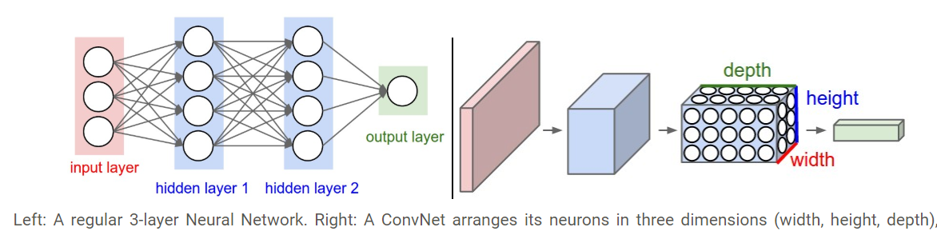
Why Convolutional Neural Networks?
2. The main advantages of convolutional neural networks are parameter sharing and sparsity of connections:
- Parameter sharing allows the reuse of feature detectors across different parts of the image, reducing the number of parameters needed.
- Sparsity of connections ensures that each output unit depends on only a subset of input features, further minimizing the required parameters.
- Convolutional Neural Networks (ConvNets) leverage the 3D structure of input images, unlike regular neural networks. In a ConvNet, layers have neurons arranged in three dimensions: width, height, and depth.
Notes:
Parameter sharing A feature detector that is useful in one part of the image is probably useful in another part of the image.Thus CNN are good in capturing translation invariance.
Sparsity of connections In each layer,each output value depends only on a small number of inputs.This makes CNN networks easy to train on smaller training datasets and is less prone to overfitting.
2.3D volumes of neurons. Convolutional Neural Networks take advantage of the fact that the input consists of images and they constrain the architecture in a more sensible way. In particular, unlike a regular Neural Network, the layers of a ConvNet have neurons arranged in 3 dimensions: width, height, depth.

Slide 7
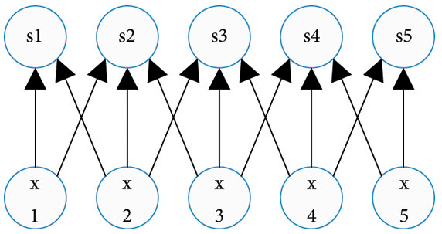
Why Convolutional Neural Networks?
Parameter sharing: A feature detector (such as a vertical edge detector) that’s useful in one part of the image is probably useful in another part of the image.

Slide 8
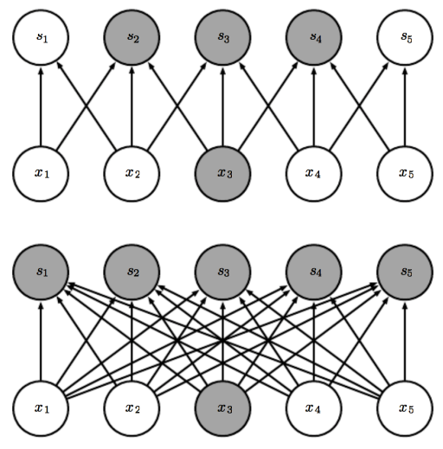
Why Convolutional Neural Networks?
Sparsity of connections: In each layer, each output value depends only on a small number of inputs.
Highlight one input x₃ and output units s affected by it.
The above image: when s is formed by convolution with a kernel of width 3, only three outputs are affected by x₃
The below image: when s is formed by matrix multiplication connectivity
is no longer sparse
– So all outputs are affected by x₃

Slide 9
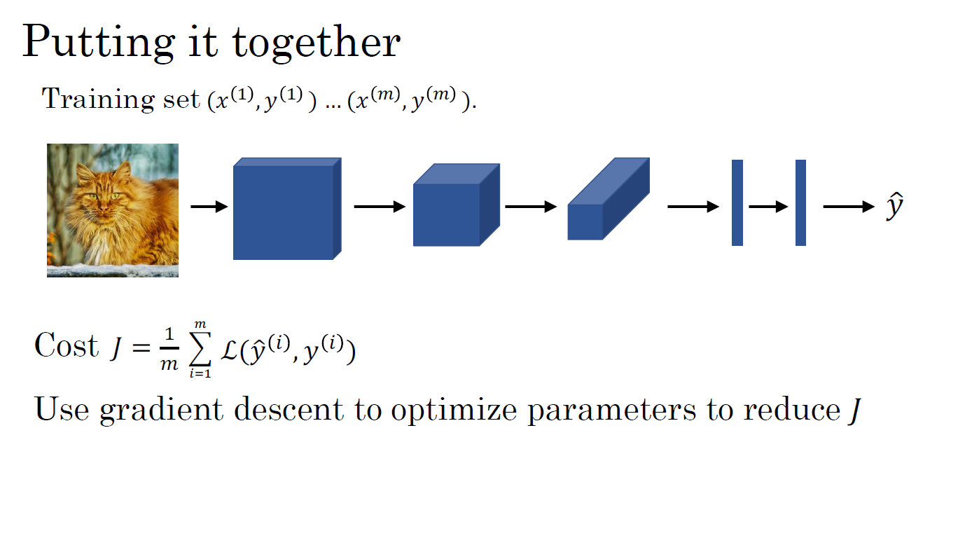

Slide 10
Convolutional Neural Networks
Computer vision

Slide 11
Computer vision
A major issue arises with large image inputs, containing millions of features, making standard fully connected networks impractical.
To overcome this, convolutional neural networks (CNNs) are introduced. CNNs use convolutions, better suited for processing large images. Convolutional networks are illustrated using the example of edge detection.
Notes:
Some of the computer vision problems studied in this module include image classification, object detection, and neural style transfer. One of the challenges of computer vision problems is that the inputs can get really big. 64 by 64 images are relatively small and have 12,288 input features, but larger images with 3 million input features are not uncommon, and the number of parameters required to process those images with a standard fully connected network is often infeasibly large.
To address this issue, convolutional neural networks are introduced. Convolutional networks use convolutions, a fundamental building block that is better suited to processing large images. The example of edge detection will be used to illustrates for convolutions using.

Slide 12

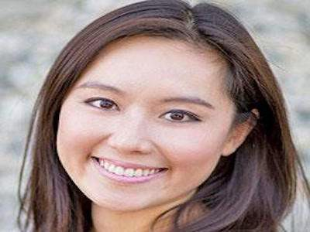
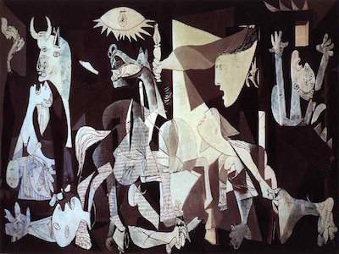
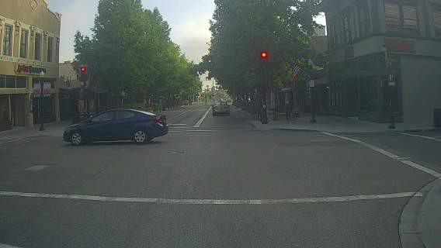
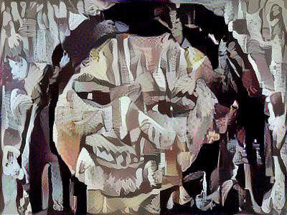
Computer Vision Problems
Image Classification
Neural Style Transfer
Cat? (0/1)
64x64x3
Object detection

Slide 13
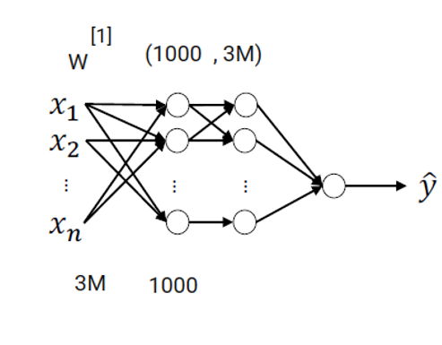
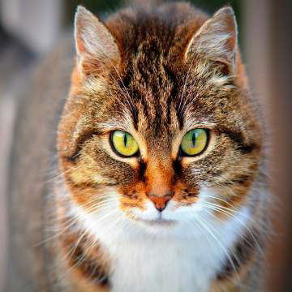
Deep Learning on large images
Cat? (0/1)
64x64x3 = 12228
1000 x 1000 x 3 = 3 M (million)

Slide 14
Convolution
Convolution is an operation done to extract features from the images as these features will be used by the network to learn about a particular image. In the case of a dog image, the feature could be the shape of a nose or the shape of an eye which will help the network later to identify an image as a dog.
Convolution operation is performed with the help of the following three elements:
1. Input Image - The image to convolve on
2. Filter/ Feature Detector/Kernel - They are the bunch of numbers in a matrix form intended to extract features from an image. They can be 1-dimensional, 2-dimensional or 3-dimensional
3. Output/ Feature Map/ Activation Map - The resultant of the convolution operation performed between image and feature detector gives a Feature Map.

Slide 15
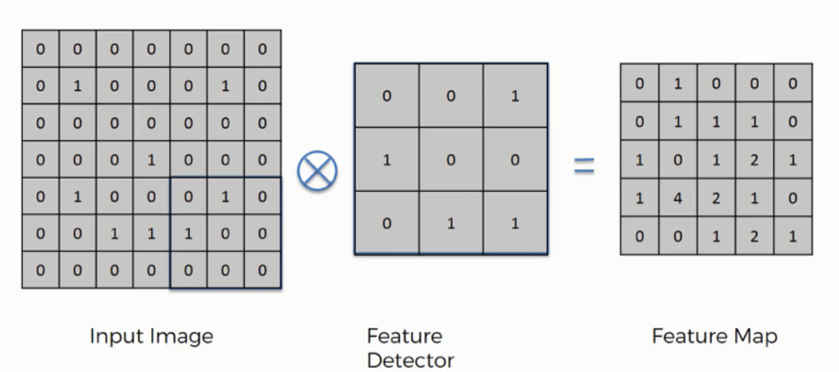
Convolution

Slide 16
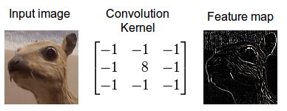
Convolution

Slide 17
Convolutional Neural Networks
Edge detection example

Slide 18
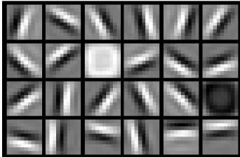
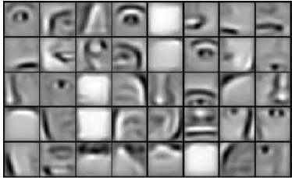
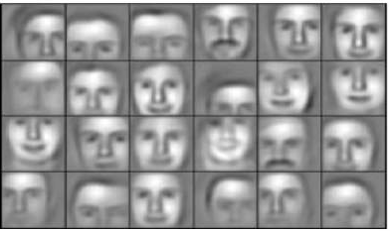
Edge detection example
The convolution operation is a fundamental part of convolutional neural networks.
Early neural network layers can identify edges, while subsequent layers progress to recognizing objects and eventually complete objects like faces.
Example 1:

Slide 19
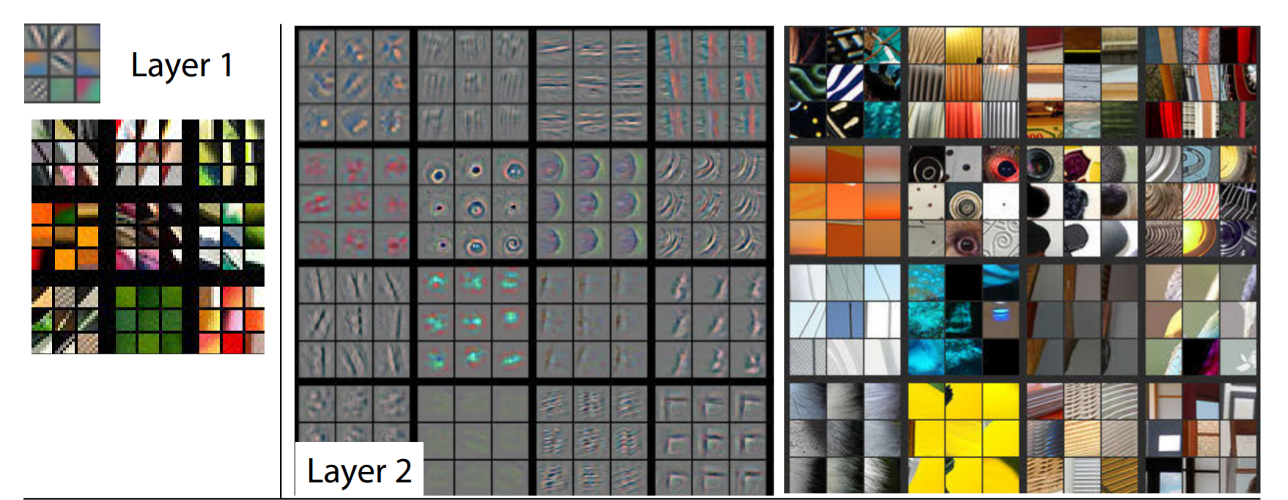
Convolution
Example 2:

Slide 20
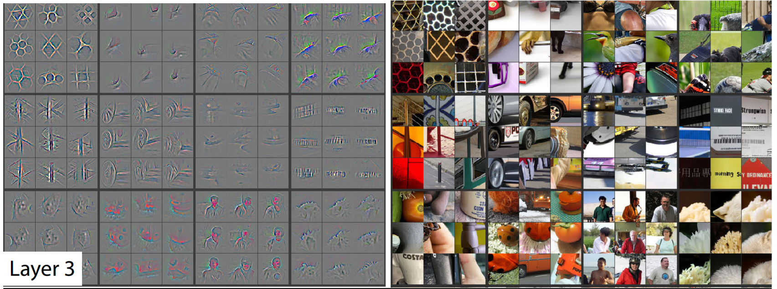
Convolution

Slide 21
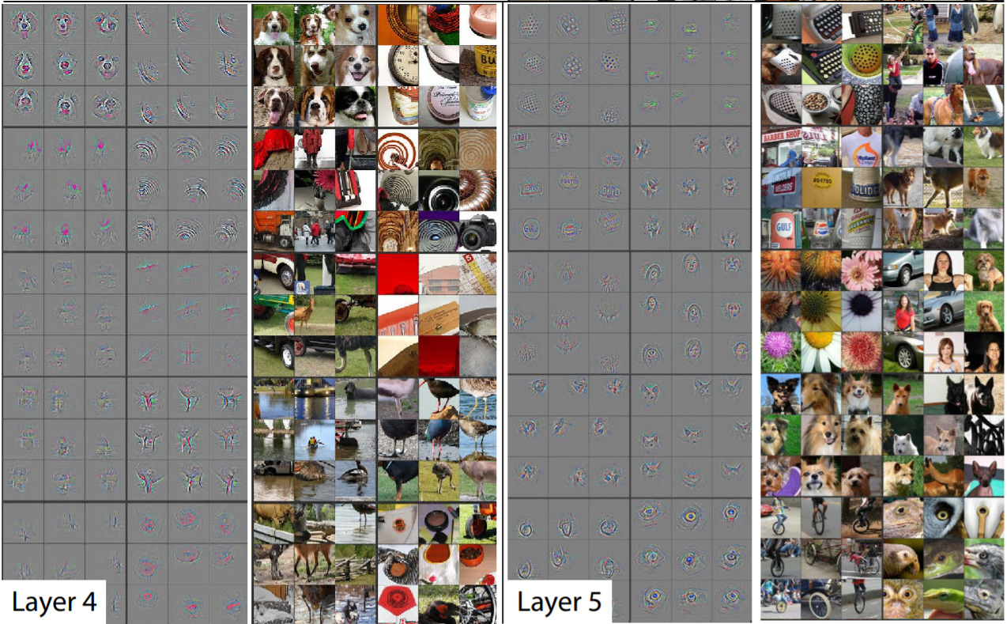
Convolution

Slide 22
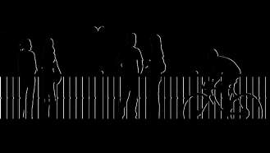

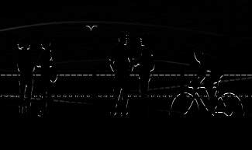
Edge detection example
To identify objects in a picture, a computer might start by detecting vertical edges, which correspond to buildings and pedestrians in the given example. Similarly, horizontal edges can be detected, such as the railing line in the image.
vertical edges
horizontal edges

Slide 23
Edge detection example
Consider an example:
- A grayscale 8x8 image.
- A 3x3 filter is constructed with weights of 1, 1, 1, 0, 0, 0, -1, -1, -1.
- The filter is convolved with the input image producing a 6x6 feature map.
- The values in the feature map correspond to the strength of vertical edges detected at different locations in the input image.
Notes:
The convolution operation is an essential operation in convolutional neural networks (CNNs) used for tasks like image classification, object detection, and segmentation. It involves convolving a filter (also called a kernel) with an input image to produce a feature map. The filter is a small matrix of numbers that is designed to detect specific features in the input image, such as edges, corners, or blobs.
In the example given, the goal is to detect vertical edges in a grayscale 6 by 6 image. A 3 by 3 filter is constructed with weights of 1, 1, 1, 0, 0, 0, -1, -1, -1. The filter is convolved with the input image using element-wise multiplication and addition, producing a 4 by 4 feature map. The values in the feature map correspond to the strength of vertical edges detected at different locations in the input image. The process is repeated with different filters to detect other features like horizontal edges, corners, and blobs.
The convolution operation is a computationally efficient way of detecting features in images, and it is used extensively in CNNs. The resulting feature maps can be used as inputs to subsequent layers of the network for further processing and feature extraction.

Slide 24
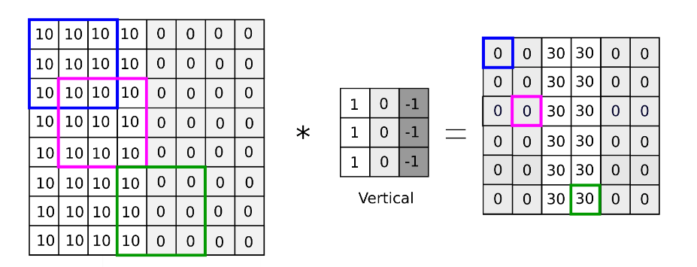
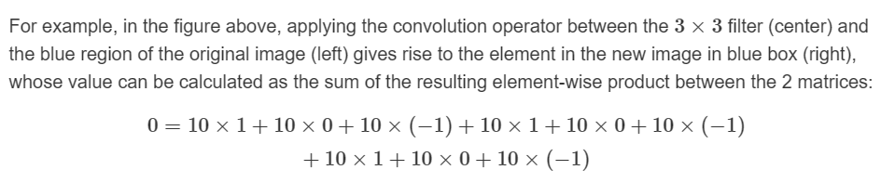
Vertical edge detection

Slide 25
Convolutional Neural Networks
More edge detection

Slide 26
More edge detection
Convolutional operations and edge detection:
- The vertical edge detection filter detects edges where pixels are bright on the left and dark on the right.
- The same filter can be used to detect horizontal edges, where pixels are bright on top and dark on the bottom.
The concept of positive and negative edges, which are transitions from light to dark or dark to light, respectively: - The same vertical edge detection filter behaves differently when applied to an image with colors flipped, where the darker colors are on the left and brighter colors are on the right. In this case, the filter detects negative edges instead of positive edges.
Other types of edge detection filters, such as the Sobel and Scharr filters, which are alternatives to the traditional vertical edge detection filter. These filters have different weightings and properties that make them more robust in detecting edges in certain types of images.

Slide 27
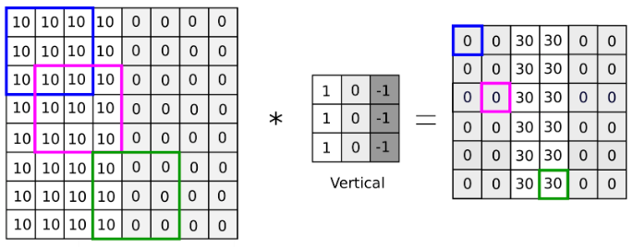
Vertical edge detection examples
Notes:
For example, in the figure above, applying the convolution operator between the 3×33×3 filter (center) and the blue region of the original image (left) gives rise to the element in the new image in blue box (right), whose value can be calculated as the sum of the resulting element-wise product between the 2 matrices:0=10×1+10×0+10×(−1)+10×1+10×0+10×(−1)+10×1+10×0+10×(−1)

Slide 28
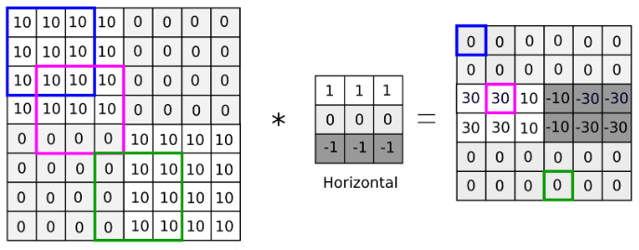
Horizontal edge detection examples
Notes:
Another example is shown above with a horizontal edge detector with a slightly more complicated image. The non-zero band in the middle reveals the horizontal edge in the center of the original image but also discovers the change from bright to dark (left side) and dark to bright (right side).

Slide 29
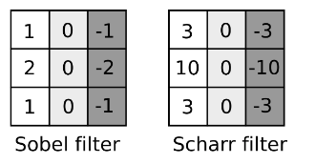
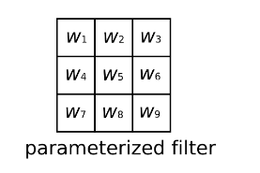
Learning to detect edges
1 | 0 | -1
1 | 0 | -1
1 | 0 | -1
Traditional vertical edge filter
3 | 0 | 1 | 2 | 7 | 4
1 | 5 | 8 | 9 | 3 | 1
2 | 7 | 2 | 5 | 1 | 3
0 | 1 | 3 | 1 | 7 | 8
4 | 2 | 1 | 6 | 2 | 8
2 | 4 | 5 | 2 | 3 | 9
#$ | #% | #&
#' | #₍ | #₎
#* | #₊ | #,
Notes:
And with the rise of deep learning, one of the things we learned is that when you really want to detect edges in some complicated image, maybe you don't need to have computer vision researchers handpick these nine numbers. Maybe you can just learn them and treat the nine numbers of this matrix as parameters, which you can then learn using back propagation. And the goal is to learn nine parameters so that when you take the image, the six by six image, and convolve it with your three by three filter, that this gives you a good edge detector

Slide 30
More edge detection
Using backpropagation to learn the values of the filter weights automatically:
- Rather than hand-coding the filter values, a neural network can learn them by adjusting the weights during training. This allows the network to learn edge detection filters that are more effective and efficient than hand-coded filters.
Padding and stride, which are variations on the basic convolution operation:
- Padding involves adding additional pixels around the edge of an image to prevent the output from being smaller than the input after convolution.
- Stride involves skipping some of the pixels in the input during convolution, resulting in a smaller output. These variations are important building blocks for convolutional neural networks.

Slide 31
Convolutional Neural Networks
Padding

Slide 32
Padding
The basic convolutional operation creates two problems:
- Firstly, if you apply convolutional operators repeatedly, the image shrinks in size every time, eventually resulting in a very small image.
- Secondly, pixels on the edges of the image are touched by fewer filters, leading to the loss of important information near the edges.
Padding addresses this by adding zeros to the input image edges before convolution, preventing size reduction and ensuring edge pixels are influenced by more filters.
Conventionally, padding is denoted as 'p,' representing the added pixels to each edge of the input image.
Notes:
Padding is a modification to the basic convolutional operation that is necessary when building deep neural networks. The basic convolutional operation involves convolving an input image with a filter, resulting in an output with smaller dimensions.
However, this creates two problems:
- Firstly, if you apply convolutional operators repeatedly, the image shrinks in size every time, eventually resulting in a very small image.
- Secondly, pixels on the edges of the image are touched by fewer filters, leading to the loss of important information near the edges.
Padding solves both these problems by adding a border of zeros to the edges of the input image before convolution. This increases the size of the input image and ensures that pixels on the edges are touched by more filters. By convention, the padding is specified as the number of pixels added to each edge of the input image, and the amount of padding is denoted as 'p'.
There are two common choices of padding:
- Valid convolution and same convolution. In a valid convolution, no padding is added to the image, and the resulting output has smaller dimensions than the input.
- In contrast, in a same convolution, the padding is added such that the output has the same dimensions as the input. For a filter of size f, the amount of padding required for same convolution is p = (f-1)/2 when f is odd. In computer vision, odd-sized filters are usually preferred to ensure a natural padding region with the same dimension all around and to have a central pixel for position reference.
In summary, padding is used to prevent the shrinking of the image size and to preserve important information near the edges of the image. By specifying the amount of padding or choosing between valid and same convolutions, you can control the output size of the convolution operation.

Slide 33
Padding
Input: n x n
Padding: p
Filter size: f x f
Output: (n+2p-f+1) x (n+2p-f+1)
Notes:
There are two common choices of padding: valid convolution and same convolution:
- Same convolution (also called "same" padding): In zero padding, extra rows and columns of zeros are added around the input image before applying the convolution. This ensures that the spatial dimensions of the output feature map are the same as those of the input image, assuming a stride of 1. Zero padding helps to retain more spatial information from the original image and prevents excessive reduction in feature map size.
- Valid convolution (also called "no padding" or "valid" convolution): In valid padding, no padding is added to the input image. As a result, the convolutional operation only takes place where the filter can fully overlap with the input image. This typically results in a smaller output feature map compared to the input.

Slide 34
Padding
There are two common choices for padding:
1. Valid: It means no padding. If we are using valid padding, the output will be (n-f+1) X (n-f+1)
2. Same: Here, we apply padding so that the output size is the same as the input size, i.e.,
n+2p-f+1 = n
So, p = (f-1)/2
Notes:
There are two common choices of padding: valid convolution and same convolution:
- Same convolution (also called "same" padding): In zero padding, extra rows and columns of zeros are added around the input image before applying the convolution. This ensures that the spatial dimensions of the output feature map are the same as those of the input image, assuming a stride of 1. Zero padding helps to retain more spatial information from the original image and prevents excessive reduction in feature map size.
- Valid convolution (also called "no padding" or "valid" convolution): In valid padding, no padding is added to the input image. As a result, the convolutional operation only takes place where the filter can fully overlap with the input image. This typically results in a smaller output feature map compared to the input.

Slide 35
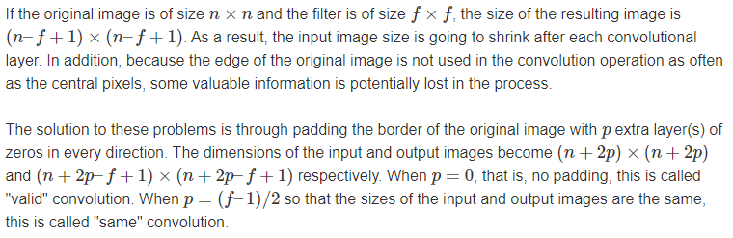
Padding

Slide 36
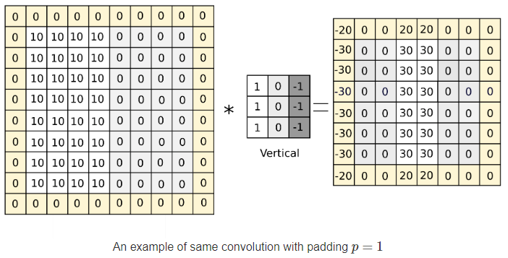
Padding

Slide 37
Convolutional Neural Networks
Strided convolutions

Slide 38
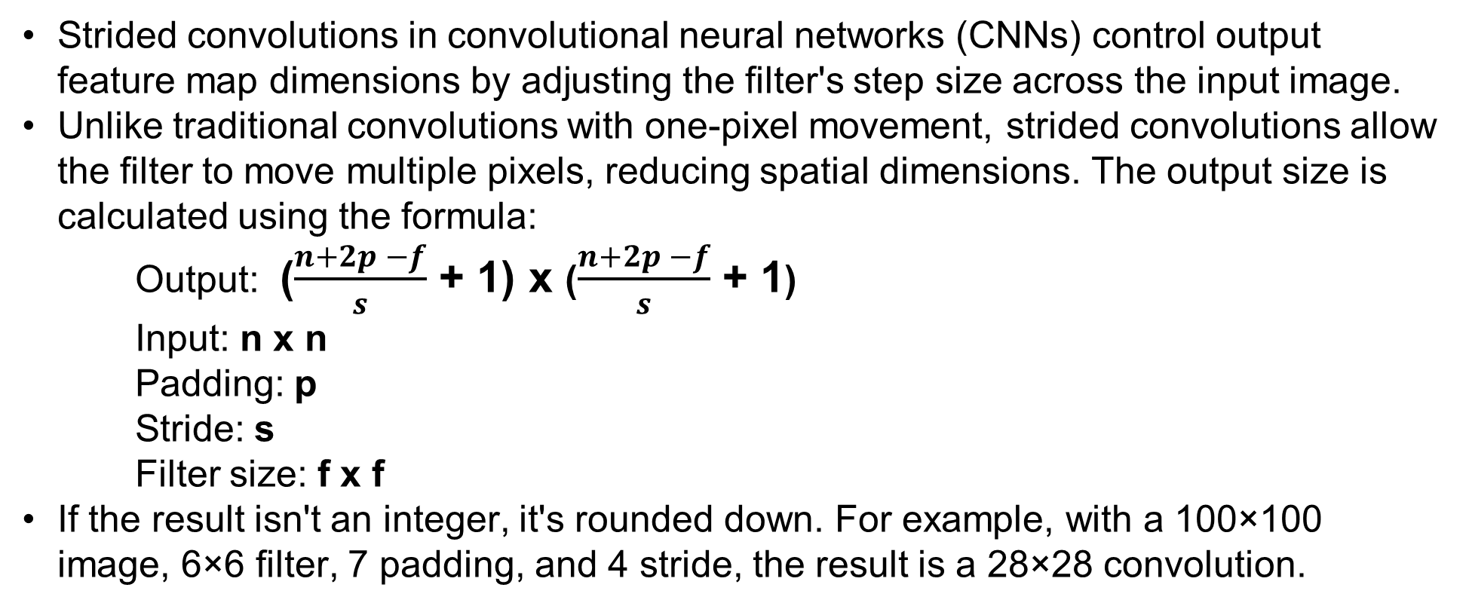
Strided convolutions
Strided convolutions in convolutional neural networks (CNNs) control output feature map dimensions by adjusting the filter's step size across the input image.
Unlike traditional convolutions with one-pixel movement, strided convolutions allow the filter to move multiple pixels, reducing spatial dimensions. The output size is calculated using the formula:
Output: ($\frac{n+2p −f}{s}$ + 1) x ($\frac{n+2p −f}{s}$ + 1)
Input: n x n
Padding: p
Stride: s
Filter size: f x f
If the result isn't an integer, it's rounded down. For example, with a 100×100 image, 6×6 filter, 7 padding, and 4 stride, the result is a 28×28 convolution.
Notes:
Strided convolutions are a technique used in convolutional neural networks (CNNs) to control the spatial dimensions of the output feature maps by adjusting the step size at which the convolutional filter moves across the input image.
In traditional convolutions, a filter typically moves one pixel at a time, which results in output feature maps with similar spatial dimensions as the input. Strided convolutions, however, allow the filter to move multiple pixels at a time, resulting in a reduction of the spatial dimensions of the output feature maps.
In a stride convolution, the filter is applied to the input image with a specific stride value, skipping over certain input values in the process. The output size of the convolution is then determined according to the formula:
Output size = (input size + 2 * padding size - filter size) / stride + 1
If the result of this formula is not an integer, the output size is rounded down to the nearest integer.
For example, if an image is 100×100, a filter is 6×6, the padding is 7, and the stride is 4, the result of convolution will be (100 – 6 + (2)(7)) / 4 + 1 = 28×28.

Slide 39
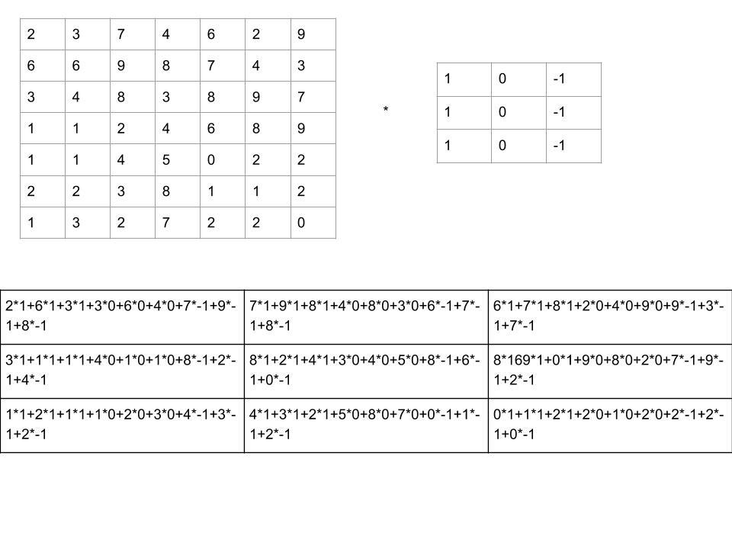
Strided convolutions
Image obtained after convolution of 6×6 image with a 3×3 filter and a stride of 2

Slide 40
Strided convolutions
Stride convolutions, a variant of convolutional operations in deep learning, skip over specific input values, enhancing computational efficiency.
Although there's terminology inconsistency, such as using cross-correlation, it usually doesn't significantly impact CNN implementation or understanding.
Notes:
One key difference between stride convolutions and regular convolutions is that the former involves skipping over certain input values during the convolution operation, while the latter does not. This can lead to more efficient and faster computation in some cases.
It's also worth noting that there is some inconsistency in the terminology used for convolution operations in different fields, such as signal processing and mathematics. In some cases, what is referred to as a convolution operation in the context of CNNs may actually be a cross-correlation operation, which involves flipping the filter before applying it to the input image. However, in practice, this distinction doesn't usually matter much for CNN implementation or understanding.

Slide 41
Convolutional Neural Networks
Convolutions over volumes

Slide 42
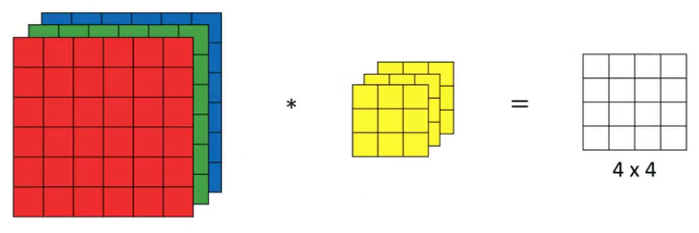
Convolutions on RGB image
Consider implementing convolutions over 3D volumes, suppose we have a 3-D input image of shape 6 x 6 x 3. How will we apply convolution on this image? We will use a 3 x 3 x 3 filter instead of a 3 x 3 filter. Let’s look at an example:
- Input: 6 x 6 x 3
- Filter: 3 x 3 x 3
The dimensions above represent the height, width and channels in the input and filter.. Keep in mind that the number of channels in the input and filter should be same. This will result in an output of 4 x 4. Let’s understand it visually:
Notes:
In this explanation, we are discussing how to implement convolutions over 3D volumes, specifically for RGB images. An RGB image can be thought of as a stack of three 2D images, where each corresponds to a color channel (red, green, blue). To detect features in such an image, we can use a 3D filter that has a height, width, and depth (matching the image's height, width, and number of color channels). We can slide this filter over the image and compute the output using the dot product between the filter and the corresponding portion of the image. By convolving a 6x6x3 image with a 3x3x3 filter, we get a 4x4x1 output.
By using different filters, we can detect different features in the image. For example, a filter that detects vertical edges in the red channel could have weights of 1, 1, 1, -1, -1, -1, 0, 0, 0, for the red, green, and blue channels, respectively. By using multiple filters, we can detect multiple features simultaneously. The output of each filter is stacked together to form a 3D volume, where the number of channels equals the number of filters used.

Slide 43
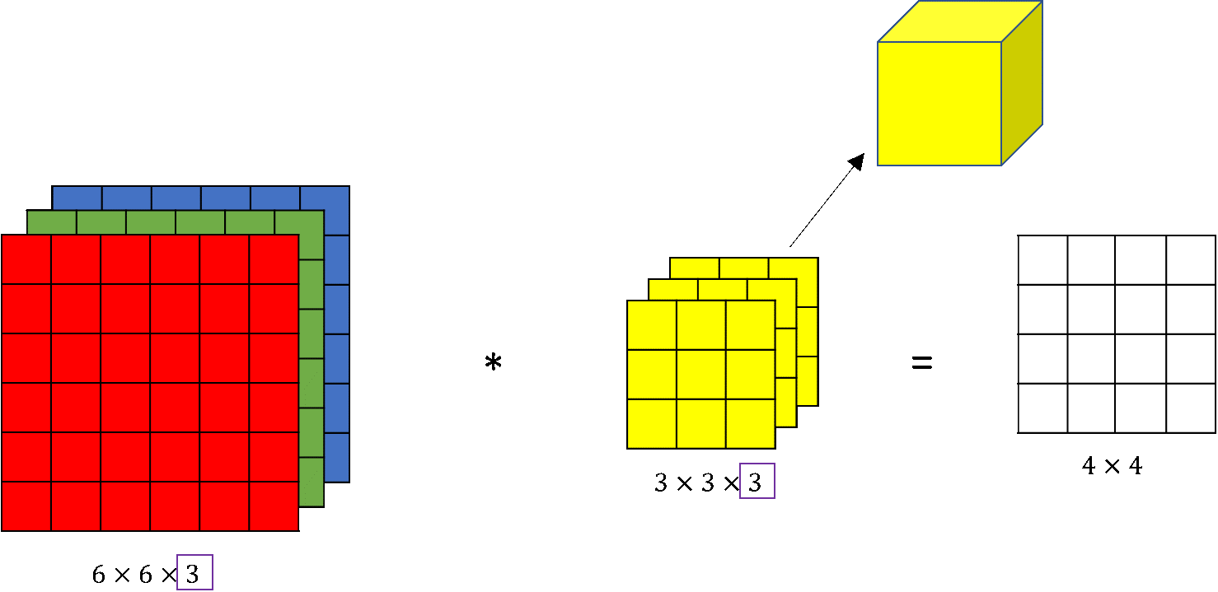
Convolutions on RGB image
The filter we use we can consider as a volume
Notes:
Here we can see the 6x6x3 image and the 3x3x3 filter. The last number is the number of channels and it matches between the image and the filter. To simplify the drawing the 3x3x3 filter, we can draw it as a stack of three matrices. Sometimes, the filter is drawn as a three-dimensional cube as we can see in the image below.
To compute the output of this convolution operation, we take the 3x3x3 filter and first place it in that most upper left position. Notice that 3x3x3 filter has 27 numbers. We take each of these 27 numbers and multiply them with the corresponding numbers from the red, green and blue channel. So, take the first nine numbers from red channel, then the three beneath it for the green channel, then three beneath it from the blue channel and multiply them with the corresponding 27 numbers covered by this yellow cube. Then, we add up all those numbers and this gives us the first number in the output. To compute the next output we take this cube and slide it over by one. Again we do the twenty-seven multiplications sum up 27 numbers and that gives us the next output.

Slide 44
Convolutions on RGB image
By sliding the filter over the image and computing the output using the dot product, we can get an output volume.
Different filters can be used to detect different features in the image, and the outputs of each filter can be stacked to form a 3D volume.
Notes:
In this explanation, we are discussing how to implement convolutions over 3D volumes, specifically for RGB images. An RGB image can be thought of as a stack of three 2D images, where each corresponds to a color channel (red, green, blue). To detect features in such an image, we can use a 3D filter that has a height, width, and depth (matching the image's height, width, and number of color channels). We can slide this filter over the image and compute the output using the dot product between the filter and the corresponding portion of the image. By convolving a 6x6x3 image with a 3x3x3 filter, we get a 4x4x1 output.
By using different filters, we can detect different features in the image. For example, a filter that detects vertical edges in the red channel could have weights of 1, 1, 1, -1, -1, -1, 0, 0, 0, for the red, green, and blue channels, respectively. By using multiple filters, we can detect multiple features simultaneously. The output of each filter is stacked together to form a 3D volume, where the number of channels equals the number of filters used.

Slide 45
Convolutions on RGB image
27 numbers
When we apply 3x3x3 filter on the RGB image it is as we implement the volume
Notes:
Here we can see the 6x6x3 image and the 3x3x3 filter. The last number is the number of channels and it matches between the image and the filter. To simplify the drawing the 3x3x3 filter, we can draw it as a stack of three matrices. Sometimes, the filter is drawn as a three-dimensional cube as we can see in the image below.

Slide 46
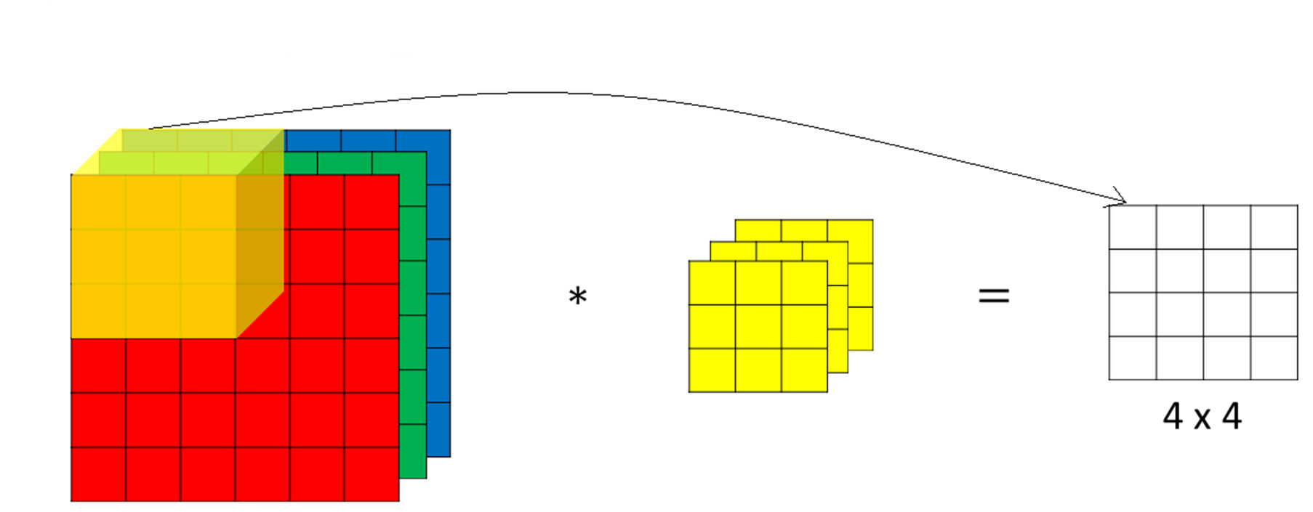
Convolutions on RGB image

Slide 47
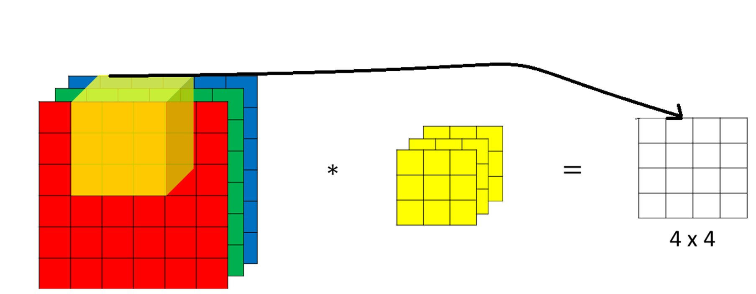
Convolutions on RGB image

Slide 48
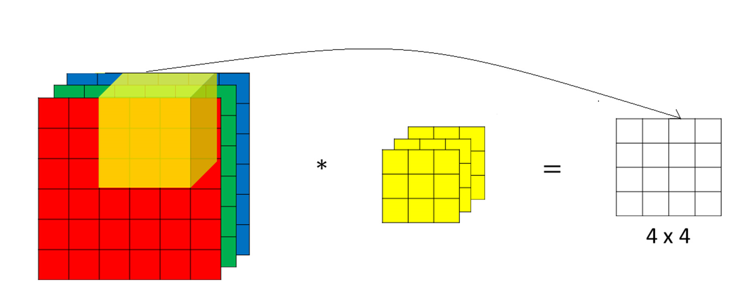
Convolutions on RGB image

Slide 49
Multiple filters
Instead of using just a single filter, we can use multiple filters as well. How do we do that?
Let’s say the first filter will detect vertical edges and the second filter will detect horizontal edges from the image. If we use multiple filters, the output dimension will change. So, instead of having a 4 x 4 output as in the above example, we would have a 4 x 4 x 2 output (if we have used 2 filters).

Slide 50
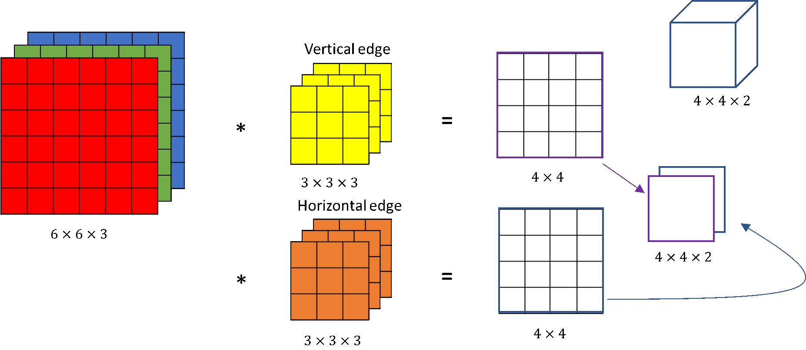
Multiple filters
When we convolve with two different filters simultaneously
Notes:
We can add a new second filter denoted by orange color, which could be a horizontal edge detector. Convolving an image with the filters gives us different 4x4 outputs. These two 4x4 outputs, can be stacked together obtaining a 4x4x2 output volume. The volume can be drawn this as a box of a 4x4x2 volume, where 2 denotes the fact that we used two different filters.

Slide 51
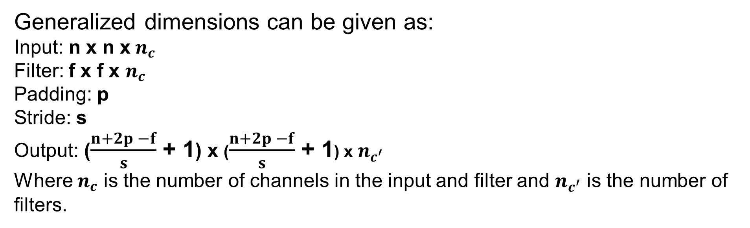
Multiple filters
Generalized dimensions can be given as:
Input: n x n x${ n}_{c}$
Filter: f x f x $n_{c}$
Padding: p
Stride: s
Output: ($\frac{n+2p −f}{s}$ + 1) x ($\frac{n+2p −f}{s}$ + 1) x $n_{c^{′}}$
Where $n_{c}$ is the number of channels in the input and filter and $n_{c^{′}}$ is the number of filters.

Slide 52
Convolutional Neural Networks
One layer of a convolutional network

Slide 53
One layer of a convolutional network
Building a single layer in a convolutional neural network (CNN) involves convolving a 3D volume with different filters, applying biases and non-linearities, and stacking the 4x4 output to form a 4x4x2 output volume.
The notation used to describe one layer of a CNN is explained, including filter size, padding, stride, and number of channels. The output volume size is calculated using a formula, and the weights and biases are also explained. There is no universal convention for the ordering of height, width, and channel, but the video follows the convention of listing height and width first and then the number of channels last. Understanding one layer of a CNN is essential for building a deeper CNN.
Notes:
This section explains how to build a single layer of a convolutional neural network (CNN) by convolving a 3D volume with different filters and applying biases and non-linearities. The output of this layer is a 4x4 output, which is then stacked to form a 4x4x2 output volume. This computation from a 6x6x3 input to a 4x4x2 output is considered one layer of a CNN.
The section also explains the notation used to describe one layer of a CNN. The notation includes f[l] for the filter size, p[l] for the padding, s[l] for the stride, and nc[l] for the number of channels. The size of the volume in layer l is nh by nw by nc with superscript squared bracket l. The output volume size is given by n+2p-f/s+1, where n is the height/width of the input, p is the padding, f is the filter size, and s is the stride. The output of the layer is denoted as Al and will have the dimensions of nHl by nwl by ncl. The weights or parameters will be f[l] by f[l] by nc[l-1] times the total number of filters, and the biases will have one real number for each filter.
There is no universal convention about the ordering of height, width, and channel in the deep learning literature, but the video uses the convention of listing height and width first and then the number of channels last.
Understanding one layer of a CNN is crucial for building a deeper CNN, and through exercises, viewers can become more familiar with the notation used.

Slide 54
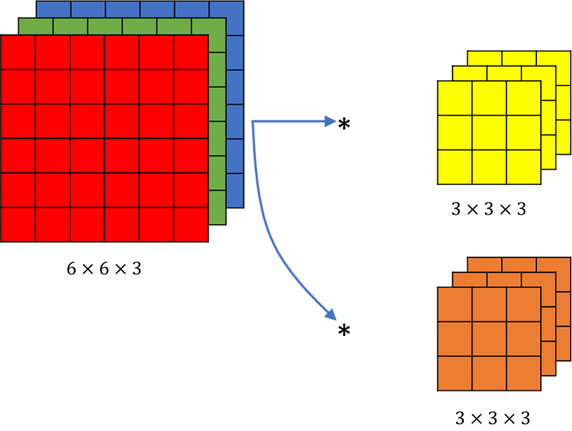
Example of a layer
Example of a convolution with two different filters

Slide 55
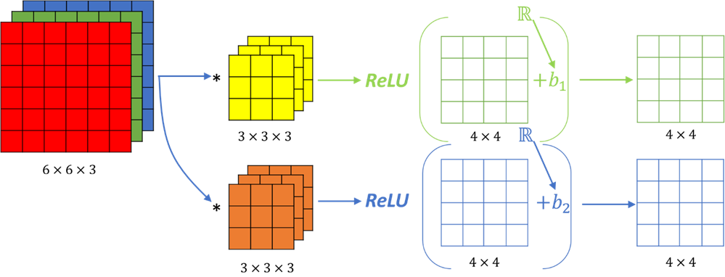
Example of a layer
The result of convolution with two filters

Slide 56
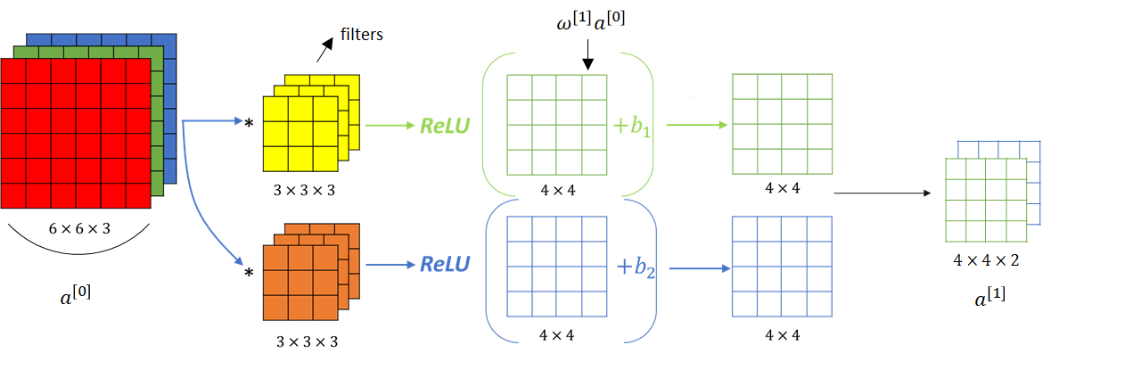
Example of a layer
The result of a convolution of 6x6x3 with two 3x3x3 is a volume of dimension 4x4x2

Slide 57
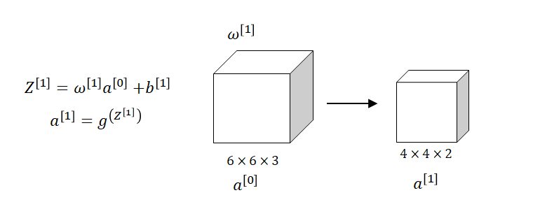
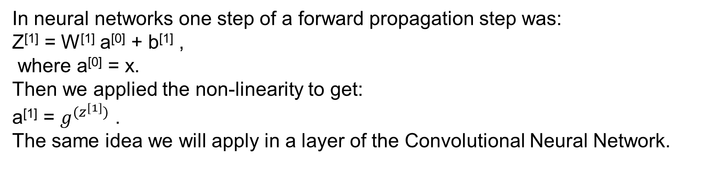
One layer of a convolutional network
In neural networks one step of a forward propagation step was:
Z^{[1]} = W^{[1]} a^{[0]} + b^{[1]} ,
where a^{[0]} = x.
Then we applied the non-linearity to get:
a^{[1]} = $g^{(z^{[1]})}$ .
The same idea we will apply in a layer of the Convolutional Neural Network.
A convolutional layer

Slide 58
Example of a layer
Compare terms used in Neural Networks with the one that we use in Convolutional Neural Networks:
In Convolutional Neural Networks (CNNs), the convolution operation involves linear operations, bias addition, and ReLU activation. For a given 6×6×3 input volume and two filters analogous to W^{[1]}, the computation results in a 4×4×2 output volume. This process includes applying:
a linear operation
adding biases
applying ReLU activation.
The transition from a^{[0]} to a^{[1]} represents the transformation from a 6×6×3 input to a 4×4×2 output in one layer of the convolutional network.
Each filter contributes to the output. If we had 10 filters instead of 2, the output becomes a 4×4×10 dimensional volume, representing a^{[1]}
Notes:
Now we will compare terms used in Neural Networks with the one that we use in Convolutional Neural Networks.
Using the analogy from neural networks, our input here is this \(6\times 6 \times 3\) volume and these convolutional filters are like \(W^{[1]} \).
During the convolution operation we’re taking these \(27 \) numbers, or really \(27 \times 2 \) because we have two filters. We’re creating all of these numbers and multiplying them so we’re really computing a linear function to get this \( 4 \) \(\times \) \( 4 \) .
In addition we also add bias, before applying activation function. This plays a role similar to \(Z \), and then finally by applying the non-linearity, this output becomes our activation at the next layer. This is how we go from \(a^{\left [ 0 \right ]} \) to \(a^{\left [ 1 \right ]} \). So, the convolution is really:
apply the linear operation
add the biases and
apply \(ReLU \)
We’ve gone from a \(6 \times 6 \times 3 \) dimensional \(a^{\left [ 0 \right ]} \) through one layer of a neural network to a \(4 \times 4 \times 2 \) dimensional \(a^{\left [ 1 \right ]} \). So, \(6 \times 6 \times 3 \) has gone to \(4\times4\times2 \) and that’s one layer of a convolutional net. In this example we had two filters involved which is why we end up with \(4 \times 4 \times 2 \) output. If we had \(10 \) filters instead of \(2 \) then would have we wound obtain a \(4\times 4\times 10 \) dimensional output volume. That is we’d be taking \(10 \) of these maps instead of \(2 \) of them, and stacking them up to form a \(4\times 4\times 10 \) output volume, and that’s how \(a^{\left [ 1 \right ]} \) would be obtained.

Slide 59
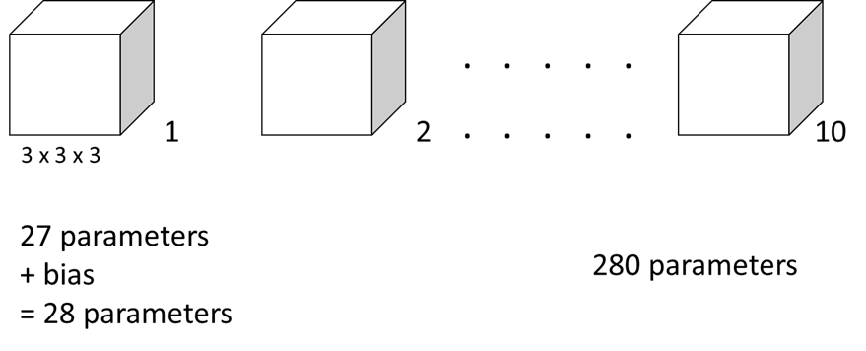
Number of parameters in one layer
If you have 10 filters that are 3 x 3 x 3 in one layer of a neural network, how many parameters does this layer have?
Notes:
In each filter, there is a \(3 \times 3 \times 3 \) volume so each filter has \(27 \) parameters to be learned. Then, we added the bias, parameter \(b \), so this gives us \(28 \) parameters. Previously we had two filters, but now if we imagine that we actually have ten of these filters, then we have \(28 \times 10 \) so that would be \(280 \) parameters. Nice point about this is that no matter how big the input images are the number of parameters will remain fixed. The input image could be \(1000 \times 1000 \) or \(5000 \times 5000\), but the number of parameters we have remains \(280 \). We can use these ten filters to detect features: vertical edges, horizontal edges, maybe other features anywhere even in the very large image with just a very small number of parameters. This is really one property of convolutional neural nets that makes them less prone to overfitting. So, once we learn ten feature detectors that work, we could apply this even to very large images and the number of parameters also remains fixed and relatively small as \(280 \) in this example.

Slide 60
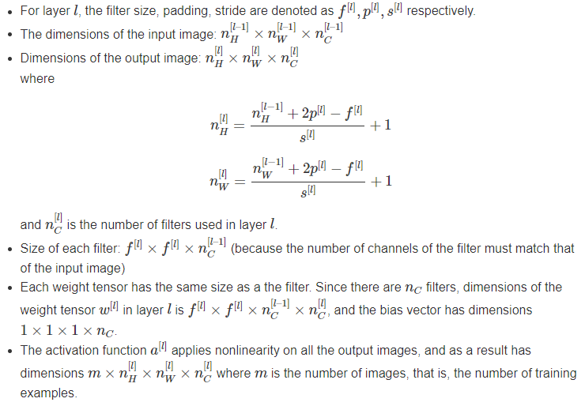
Notation
Notes:
In each filter, there is a \(3 \times 3 \times 3 \) volume so each filter has \(27 \) parameters to be learned. Then, we added the bias, parameter \(b \), so this gives us \(28 \) parameters. Previously we had two filters, but now if we imagine that we actually have ten of these filters, then we have \(28 \times 10 \) so that would be \(280 \) parameters. Nice point about this is that no matter how big the input images are the number of parameters will remain fixed. The input image could be \(1000 \times 1000 \) or \(5000 \times 5000\), but the number of parameters we have remains \(280 \). We can use these ten filters to detect features: vertical edges, horizontal edges, maybe other features anywhere even in the very large image with just a very small number of parameters. This is really one property of convolutional neural nets that makes them less prone to overfitting. So, once we learn ten feature detectors that work, we could apply this even to very large images and the number of parameters also remains fixed and relatively small as \(280 \) in this example.

Slide 61
Convolutional Neural Networks
A simple convolution network example

Slide 62
A simple convolution network example
Consider a concrete example of building a convolutional neural network (ConvNet) for image classification or recognition. The example uses a small image of size 39 x 39 x 3, where 3 represents the number of channels in the image (RGB).
- The first layer uses 3 x 3 filters with a stride of 1 and no padding, and 10 filters are used in this layer. Using this configuration, the output size of this layer becomes 37 x 37 x 10.
- The second layer uses 5 x 5 filters with a stride of 2 and no padding, and 20 filters are used in this layer. The output size of this layer becomes 17 x 17 x 20.
- The third and final layer uses 5 x 5 filters with a stride of 2 and no padding, and 40 filters are used in this layer. The output size of this layer becomes 7 x 7 x 40. The output of this layer is flattened into a vector of size 1,960 and fed into a logistic regression unit or softmax unit for the final prediction.

Slide 63
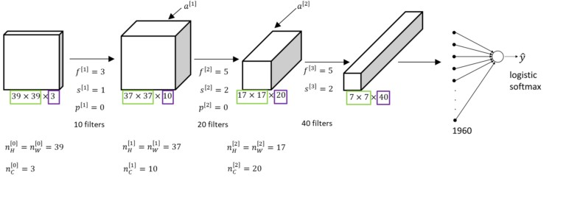
Example of ConvNet

Slide 64
Types of layer in a convolutional network:
Convolution
Pooling
Fully connected
Notes:
There are three common types of layers in a ConvNet: convolutional layer, pooling layer, and fully connected layer. In this example, only convolutional layers are used, but in typical ConvNets, pooling and fully connected layers are also included.
Pooling layers and fully connected layers are simpler to define than convolutional layers and will be covered in the next couple of section.
As you go deeper in a neural network, typically you start off with larger images, and the height and width gradually trend down as you go deeper in the neural network. Meanwhile, the number of channels generally increases. More guidelines will be provided on how to design the parameters of a ConvNet in later sections.
Training a ConvNet involves using backpropagation, which the viewers are already familiar with. The next section will cover how to implement a pooling layer for a ConvNet.

Slide 65
Convolutional Neural Networks
Pooling layers

Slide 66
Pooling layers
Pooling layers are used in Convolutional Neural Networks (ConvNets) to reduce the size of the representation, which can speed up computation and make some of the features more robust.
One common type of pooling is max pooling, where the input is divided into non-overlapping regions, and the maximum value of each region is taken to form the output. The hyperparameters of max pooling are the filter size (f) and the stride (s). The filter size determines the size of the regions that are pooled, and the stride determines the step size when moving to the next region. Max pooling has no parameters to learn, and the computation is fixed once the hyperparameters are set.
Average pooling is another type of pooling where the average value within a pooling window is taken.
Notes:
In Convolutional Neural Networks (ConvNets), pooling layers are often used in addition to convolutional layers. The purpose of pooling layers is to reduce the size of the representation, which can speed up computation and make some of the features more robust.
One common type of pooling is max pooling, where the input is divided into non-overlapping regions, and the maximum value of each region is taken to form the output. For example, a 4x4 input can be divided into four 2x2 regions, and the maximum value of each region is computed to form a 2x2 output.
The hyperparameters of max pooling are the filter size (f) and the stride (s). The filter size determines the size of the regions that are pooled, and the stride determines the step size when moving to the next region. Max pooling has no parameters to learn, and the computation is fixed once the hyperparameters are set.
The intuition behind max pooling is that it preserves features that are detected anywhere in the input, while discarding features that are not detected in any region. However, the main reason why max pooling is used is because it has been found to work well in practice, and the exact reason behind its effectiveness is still not fully understood.
In addition to max pooling, another type of pooling is average pooling, where the average value of each region is taken to form the output. However, max pooling is used much more often in ConvNets, except for some cases where average pooling is used to collapse the representation.
The hyperparameters for pooling are f and s, and common choices of parameters might be f=2 and s=2, which roughly shrinks the height and width of the representation by a factor of 2. There are no parameters to learn in pooling layers, and the input and output sizes are determined by the hyperparameters and the number of input channels.
Pooling layers are often used in conjunction with convolutional layers, and in the next video, a more complex example of a ConvNet will be introduced, which will also allow for the introduction of fully connected layers.

Slide 67
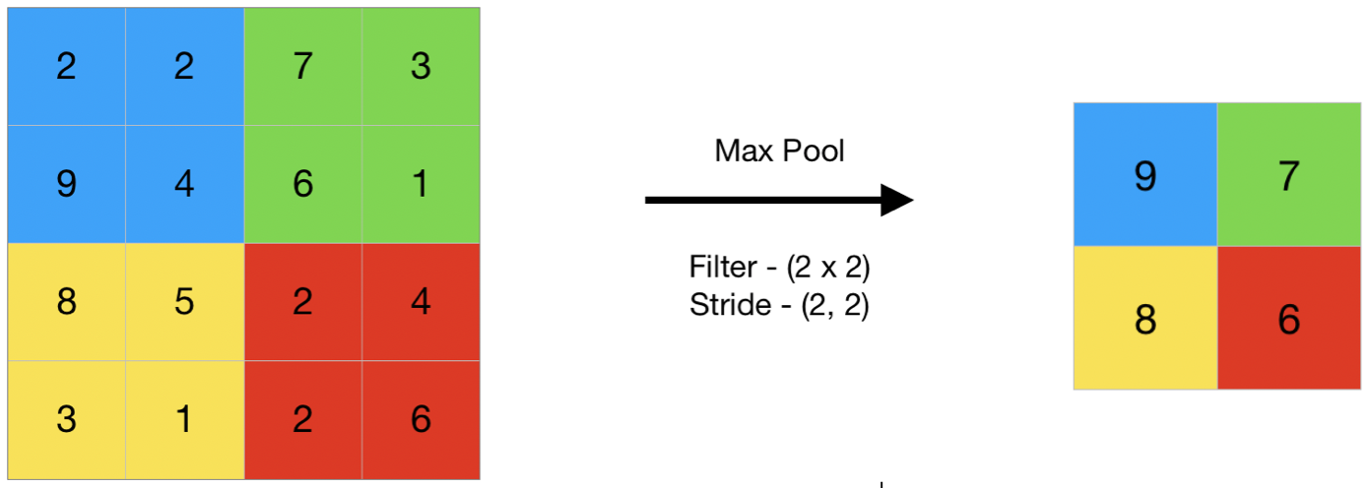
Pooling layers: Max pooling

Slide 68
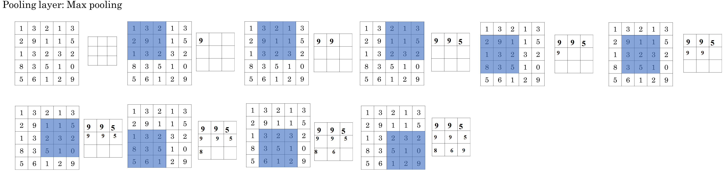
Pooling layers: Max pooling
Consider an example with a 5x5 input, filter =3 and stride = 1

Slide 69
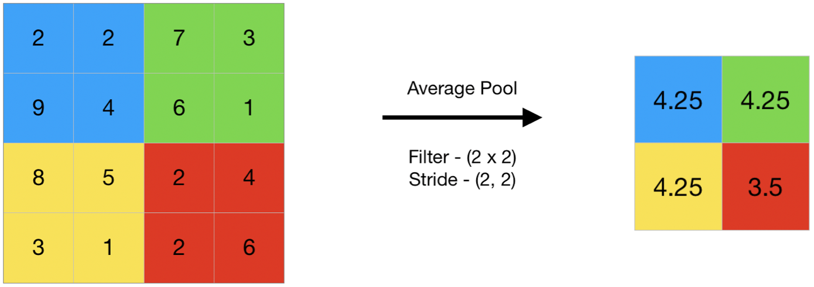
Pooling layers: Average pooling

Slide 70

Summary of pooling
Hyperparameters:
f : filter size
s : stride
For a feature map having dimensions n_{h} x n_{w} x n_{c}, the dimensions of the output volume size obtained after a pooling layer with filter size f and stride s is:

Slide 71
Advantages of Pooling Layer
Dimensionality reduction, reducing computational cost, and preventing overfitting.
Contribute to achieving translation invariance, ensuring consistent feature detection regardless of object position.
Aids in feature selection, with max pooling emphasizing salient features and average pooling preserving more information.
Notes:
Dimensionality reduction: The main advantage of pooling layers is that they help in reducing the spatial dimensions of the feature maps. This reduces the computational cost and also helps in avoiding overfitting by reducing the number of parameters in the model.
Translation invariance: Pooling layers are also useful in achieving translation invariance in the feature maps. This means that the position of an object in the image does not affect the classification result, as the same features are detected regardless of the position of the object.
Feature selection: Pooling layers can also help in selecting the most important features from the input, as max pooling selects the most salient features and average pooling preserves more information.

Slide 72
Disadvantages of Pooling Layer
Information loss: Pooling Layer discards some information from the input feature maps, which can be important for the final classification or regression task.
Over-smoothing: Pooling layers can also cause over-smoothing of the feature maps, which can result in the loss of some fine-grained details that are important for the final classification or regression task.
Hyperparameter tuning: Pooling layers also introduce hyperparameters such as the size of the pooling regions and the stride, which need to be tuned in order to achieve optimal performance. This can be time-consuming and requires some expertise in model building.
Notes:
Information loss: One of the main disadvantages of pooling layers is that they discard some information from the input feature maps, which can be important for the final classification or regression task.
Over-smoothing: Pooling layers can also cause over-smoothing of the feature maps, which can result in the loss of some fine-grained details that are important for the final classification or regression task.
Hyperparameter tuning: Pooling layers also introduce hyperparameters such as the size of the pooling regions and the stride, which need to be tuned in order to achieve optimal performance. This can be time-consuming and requires some expertise in model building.

Slide 73
Convolutional Neural Networks
Convolutional neural network example

Slide 74
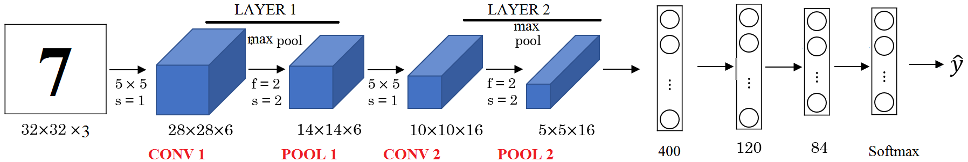
Convolutional neural network example
Consider an example of building a convolutional neural network (CNN) for handwritten digit recognition. The input image is 32x32x3, and the CNN consists of several layers, including convolutions, pooling, and fully connected layers.
Notes:
Consider an example of building a convolutional neural network (CNN) for handwritten digit recognition. The input image is 32x32x3, and the CNN consists of several layers, including convolutions, pooling, and fully connected layers.
The first layer uses a 5x5 filter with a stride of 1 and no padding, and with 6 filters applied, it produces an output of 28x28x6. This layer is followed by a pooling layer with f=2 and s=2, reducing the output size to 14x14x6.
The next layer is another convolutional layer with a 5x5 filter and 10 filters applied, producing a 10x10x10 output, followed by another pooling layer with f=2 and s=2, reducing the output size to 5x5x16.
The output is then flattened into a 400x1 vector and passed through two fully connected layers with 120 and 84 units, respectively, before being fed into a softmax unit with 10 outputs for the digit recognition task.

Slide 75
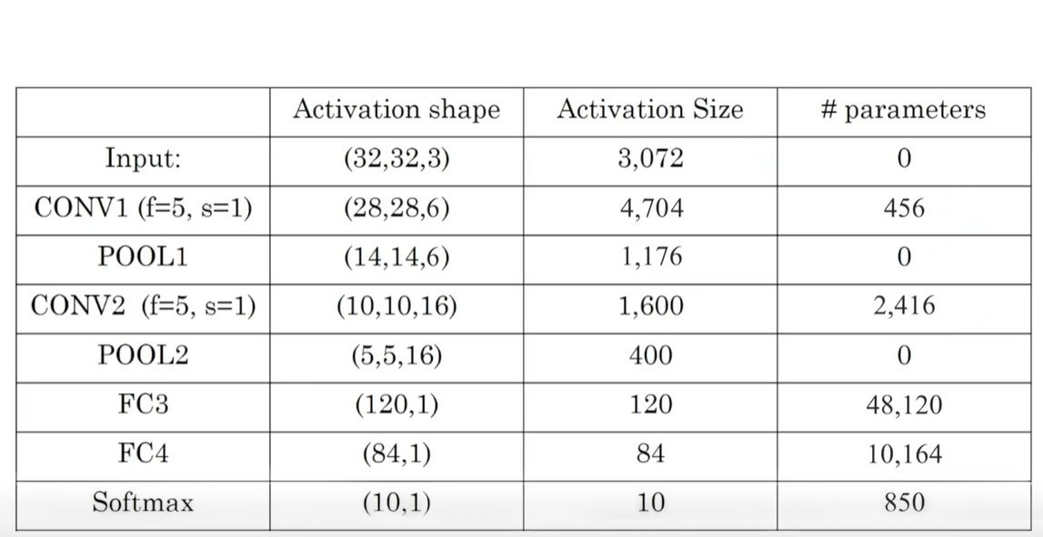
Neural network example

Slide 76
Summarization
CNNs, tailored for grid-like data, excel in tasks like image recognition by learning spatial hierarchies of features. In computer vision, they interpret visual data for tasks like image recognition and object detection.
Edge detection, a key image processing technique, highlights object boundaries. Algorithms like Sobel or Canny enhance edge detection.
Padding adds border pixels to maintain spatial information during convolutions.
Strided convolutions skip pixels, reducing output volume dimensions.
CNNs handle multi-dimensional data, like RGB images, with convolutions across all dimensions. A CNN layer involves filters applying convolutions followed by ReLU activation.
A basic CNN structure includes convolutional layers, activation functions, pooling layers, and fully connected layers.
Pooling layers reduce spatial dimensions, retaining vital information.
In a complete CNN, multiple convolutional, pooling, and fully connected layers form a deep learning architecture for tasks like image classification.
Notes:
Why Convolutional Neural Networks (CNNs)?
CNNs are designed to process grid-like data, making them ideal for tasks like image and video recognition due to their ability to automatically learn spatial hierarchies of features.
Computer Vision:
The field of computer science that enables machines to interpret and make decisions based on visual data, often involving techniques like image recognition and object detection.
Edge Detection Example:
Edge detection is a fundamental image processing technique that identifies boundaries within images, highlighting where different objects or textures meet.
More Edge Detection:
Various algorithms, like the Sobel operator or Canny edge detector, can enhance edge detection by refining the edges and reducing noise.
Padding:
Padding involves adding extra border pixels around an image, which is particularly useful in CNNs to preserve spatial dimensions and information at the borders during convolutions.
Strided Convolutions:
Strided convolutions involve skipping pixels during the convolution operation, effectively reducing the spatial dimensions of the output volume.
Convolutions Over Volumes:
CNNs can handle multi-dimensional data, such as RGB images (3D volumes), by applying convolutions across all dimensions.
One Layer of a Convolutional Network:
Describes a single layer in a CNN, which consists of multiple filters applying convolutions to the input data, followed by activation functions like ReLU.
A Simple Convolutional Network Example:
Illustrates the structure of a basic CNN, typically consisting of convolutional layers, activation functions, pooling layers, and fully connected layers for classification tasks.
Pooling Layers:
Pooling layers reduce the spatial dimensions of the input volume, retaining the most important information and reducing computation in the network.
Convolutional Neural Network Example:
Provides an overview of a complete CNN, showing how multiple convolutional and pooling layers, along with fully connected layers, form a deep learning architecture for tasks like image classification.

